Slide 1
ECG innovations in disease classification using K nearest neighbour (KNN) and fuzzy expert system
MANIPAL INSTITUTE OF TECHNOLOGY
(A constituent Institute of MANIPAL UNIVERSITY)
MANIPAL - 576 104, KARNATAKA, INDIA
Prepared by | Under the guidance of
PAVAN M SUNDER | Shri. CHANDRAMOHAN UMAPATHY
140912028 | Prof. LAWRENCE D ALMEIDA

Slide 2
Contents
Introduction.
Literature review.
Objective.
Methodology.
Results and discussion.
Innovations in this project.
Conclusion.

Slide 3
1. Introduction
General ECG analysis – study of ECG waveform printed on a chart paper.
Aim of the project – improve ECG analysis by introducing automated disease classification system. Focus is restrained to Arrhythmia classification.
Handy reference tool at the time of diagnosis and prevents interpretation errors.
ECG - The complete cycle of myocardial depolarisation is called Sinus Rhythm. The graphical representation is called Electrocardiogram (ECG).
The depolarisation begins from Sino Atrial Node (SAN), propagates throughout the conduction system and ultimately results in contraction of myocardium.

Slide 4
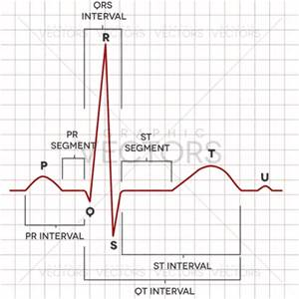
ECG has 3 prominent features – P wave, QRS complex, T wave.
ECG bandwidth - 0-250 Hz.
Unfortunately noises contaminate ECG signal during acquisition and overlap with the bandwidth of the ECG signal.
Figure 1: Sinus Rhythm[1] Courtesy: http://ekg.academy/cardiac-rhythm-analysis.aspx (free source)

Slide 5
1.1 The characteristics of an ideal ECG is tabulated below.
1.2 ECG noises
Table 1.1: Characteristics of ideal ECG [2]
FEATURE | AMPLITUDE | DURATION | FREQUENCY RANGE
P-wave | < 0.25 mv (2.5 mm) | < 0.12 s | 0.67 - 5 Hz
QRS-Complex | <4.5ms (R +S in precordial) < 2.6 mv(in V5/V6) | 0.06 - 0.10 s | 10 - 50 Hz
T wave |  |  | 1 - 7 Hz
PR interval | - | 0.12 - 0.2s | -
Table 1.2: Noise characteristics [2]
NOISE PARAMETER | FREQUENCY RANGE
Muscle noise | 5 - 50 Hz
Motion artifacts | 0.12 - 0.05 Hz
power line interference | 50 Hz
other electrical noises | > 10 Hz

Slide 6
Arrhythmias – Group of cardiac abnormalities where heart rate is irregular, either too fast or too slow.
Heart rate that is too fast is called Tachycardia and heart rate that is too slow is called Bradycardia.
In this project, a widely used clinical standard called Nova code is adopted which provides quantitative information about various parameters relevant to arrhythmia and other cardiac diseases.
From the code features related to arrhythmia are selected to develop the arrhythmia detection and classification system.

Slide 7
1.3 Disease indicators relevant to Arrhythmia from Nova Code
The disease indicators extracted from Nova code are shown below in Table 1.3:
Table 1.3: Disease indicators based on Nova code[3]
p2 (µV) | paVR (µV) | vrate (cpm) | DISEASE CLASS
> 0 | < 0 | <= 50 | Sinus Bradycardia (SB)
> 0 | < 0 | 51 - 94 | Normal Sinus Rhythm (NSR)
> 0 | < 0 | >= 95 | Sinus Tachycardia (ST)
< 0 | > 0 | <= 50 | Ectopic Atrial Bradycardia (EABR)
< 0 | > 0 | 51 - 94 | Ectopic Atrial Rhythm (EAR)
< 0 | > 0 | >= 95 | Ectopic Atrial Tachycardia (EAT)

Slide 8
1.4 Motivation
Disease interpretation - based on the study of the ECG chart by the cardiologist. An automated system serves as a handy reference tool and assist cardiologist during diagnosis.
General notion - automated systems are not authentic. Therefore Nova code is adopted to enhance the authenticity of the automated classification system.
QRS complex is one of the most important features of ECG signal. Heart rate which is one of the most critical parameter for Arrhythmia classification can be obtained by detecting QRS complex and calculating RR interval.
In this project, KNN classification is used to extract QRS complex.

Slide 9
In an ECG signal QRS complex is characterized by high slope and amplitude. Differentiation indicates rate of change. Therefore differentiated input signal is used as a feature for KNN classification.
The KNN detected R peaks may usually contain false negatives (FNs) and false positives (FPs) that can affect the determination of Heart rate. Therefore in this project, false positive (FP) and false negative (FN) correction algorithm is designed to reduce FPs and FNs.
Further P amplitudes are also relevant for Arrhythmia classification according to Nova Code. Therefore a custom designed P detection algorithm is introduced.
Fuzzy logic is adopted in the present work - disease characteristics for a particular type of disease vary over a range of values rather than definite value. Fuzzy logic can take a range of values.

Slide 10
2. Literature survey
Table 2.1: Literature Survey
Authors | Journal and year | Method | Results/Inference
F. Zhang et al. [2] | IEEE Transactions on Biomedical Circuits and Systems (2009) | Mathematical morphology | Sensitivity=99.81% Positive prediction=99.8%
I. Saini et al. [3] | Journal of Advanced Research (2013) | KNN classification | k value=3, Sensitivity=99.86,Specificity=99.86%
P. M. Rautaharju et al.[5] | Journal of Electrocardiology (1991) | Nova code standard by statistical study | Clinical standard in a hierarchical structure.

Slide 11
3. Objectives
Designing an automated Arrhythmia detection and classification system that can serve as a handy tool for doctors and other medical professionals during diagnosis and avoid interpretation errors.
QRS detection using K Nearest Neighbour (KNN) algorithm and removal of false positives (FPs) and false negatives (FNs) to compute ventricular rate (vrate).
P amplitude (P2) detection.
Define Fuzzy rules based on disease features along with their quantitative information extracted from the Nova Code.
Disease classification by KNN based on Fuzzy output.

Slide 12
4. Methodology
Testing ECG signal
Training ECG signal
Preprocessing
Classifier
Preprocessing
Fuzzy logic
Classification
(KNN)
Nova code
Class labels
QRS detection
QRS detection
Differentiation
(feature)
KNN
Disease classification
FP and FN correction and P peak detection
Figure 4.1: Project outline

Slide 13
Organized into following sections:
ECG Database
Pre-processing
Feature extraction
Classification
Simulation

Slide 14
4.1 ECG Database
MIT-BIH Supraventricular Arrhythmia database. 12 signals with apparent disease characteristics were selected from the database. The recordings were digitized at 128 samples per second.
MIT-BIH Arrhythmia database. 6 signals were randomly selected from the database. The recordings were digitized at 360 samples per second 11-bit resolution over a 10 mV range.
Laboratory signals.
5 signals were acquired from a diagnostic laboratory. Signals 1 and 4 were digitized at 2000 samples per second and the rest were sampled at 1000 samples per second.

Slide 15
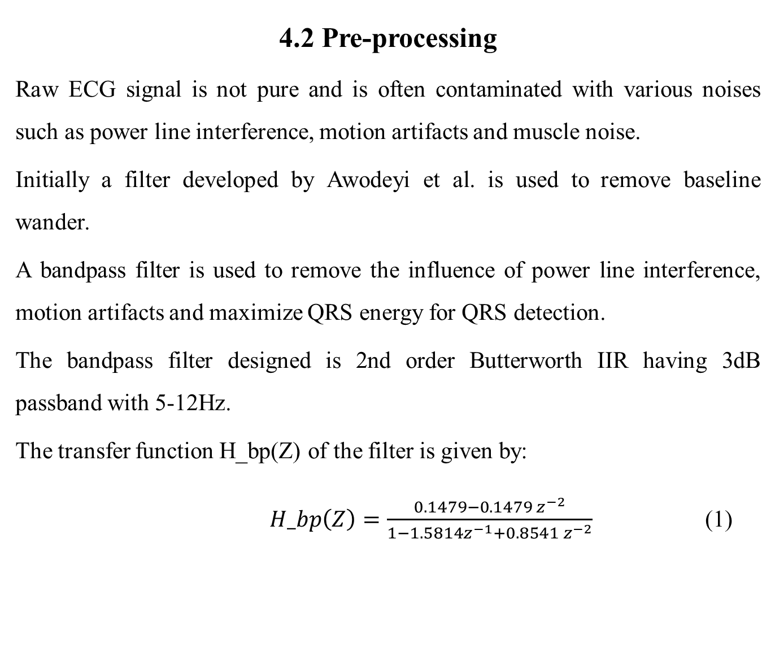
4.2 Pre-processing
Raw ECG signal is not pure and is often contaminated with various noises such as power line interference, motion artifacts and muscle noise.
Initially a filter developed by Awodeyi et al. is used to remove baseline wander.
A bandpass filter is used to remove the influence of power line interference, motion artifacts and maximize QRS energy for QRS detection.
The bandpass filter designed is 2nd order Butterworth IIR having 3dB passband with 5-12Hz.
The transfer function H_bp(Z) of the filter is given by:
$H_bp\left(Z\right)=\frac{0.1479−0.1479{ z}^{−2}}{1−1.5814z^{−1}+0.8541 z^{−2}}$ (1)

Slide 16
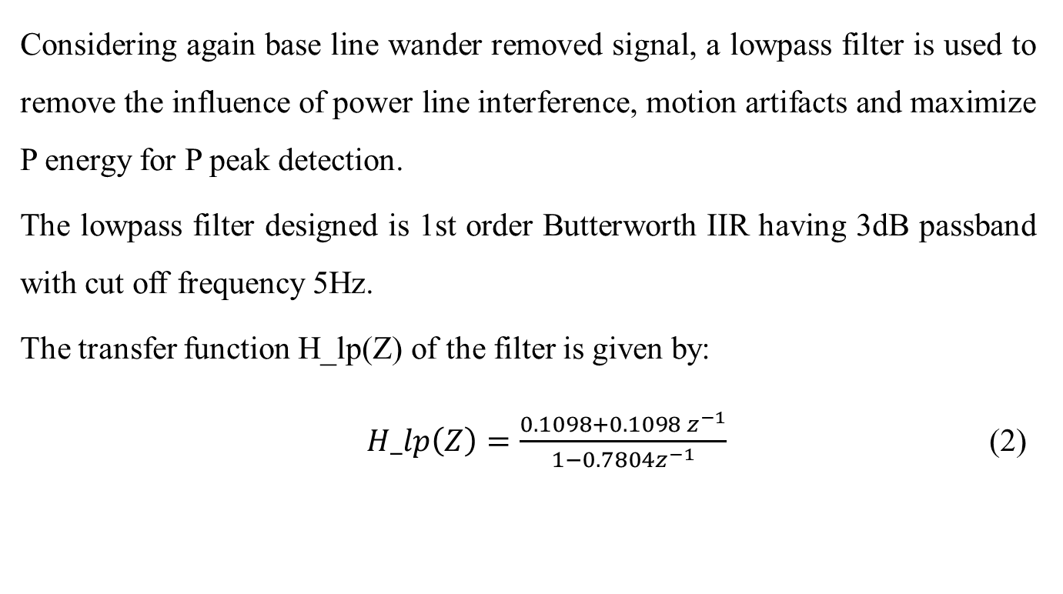
Considering again base line wander removed signal, a lowpass filter is used to remove the influence of power line interference, motion artifacts and maximize P energy for P peak detection.
The lowpass filter designed is 1st order Butterworth IIR having 3dB passband with cut off frequency 5Hz.
The transfer function H_lp(Z) of the filter is given by:
$H_lp\left(Z\right)=\frac{0.1098+0.1098{ z}^{−1}}{1−0.7804z^{−1}}$ (2)

Slide 17
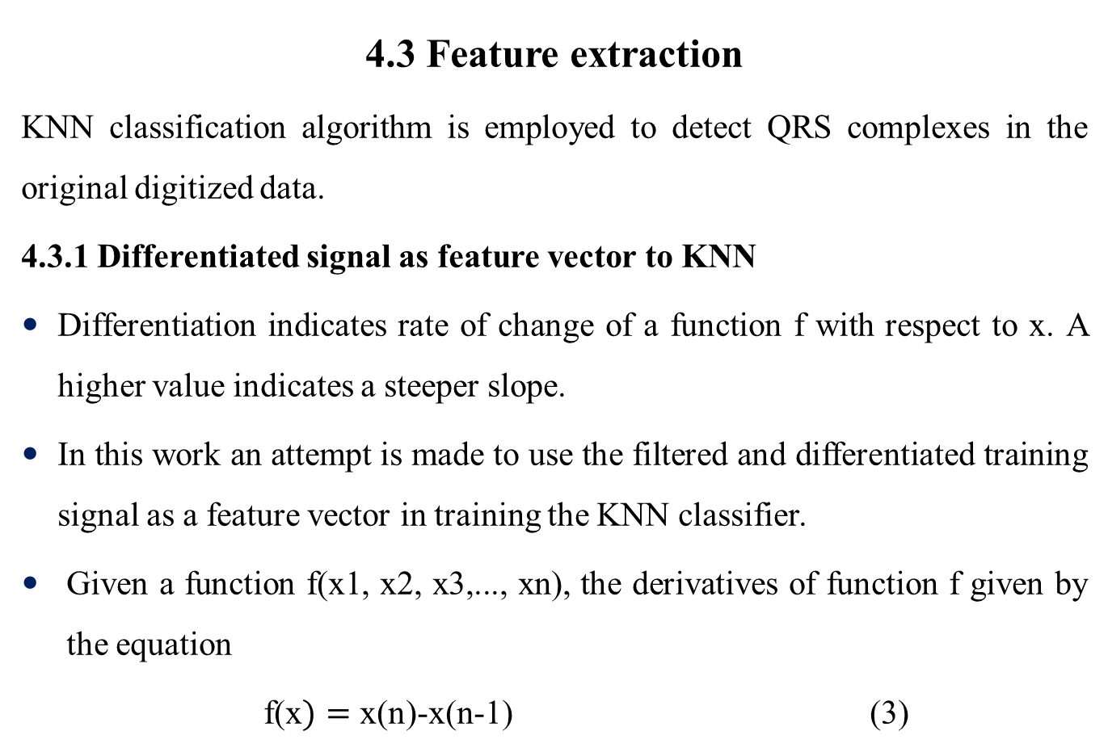
4.3 Feature extraction
KNN classification algorithm is employed to detect QRS complexes in the original digitized data.
4.3.1 Differentiated signal as feature vector to KNN
Differentiation indicates rate of change of a function f with respect to x. A higher value indicates a steeper slope.
In this work an attempt is made to use the filtered and differentiated training signal as a feature vector in training the KNN classifier.
Given a function f(x1, x2, x3,..., xn), the derivatives of function f given by the equation
f(x$)=$ x(n)-x(n-1) (3)

Slide 18
The values so obtained are normalized and used as feature vector in KNN classification model.
4.3.2 KNN classification
KNN classification involves two phases: a training phase where the inputs and their responses are stored; classification phase where new inputs are assigned a class label based on stored pattern.
Training phase
Inputs :
Record 800 of MIT-BIH Supraventricular Arrhythmia Database with size [1x7680].
Record 100 of MIT-BIH Arrhythmia Database with size [1x21600].
Record 1 of laboratory signals.

Slide 19
The digitized signal is filtered with a bandpass filter centered at 5-12 Hz.
The signal is differentiated based on equation (3).
The response variable to KNN is generated with QRS regions classified as 1 and non QRS regions classified as 0.
‘k’ value of 3 and Euclidean distance metric is chosen as suggested by I. Saini et al.
Based on chosen parameter values KNN classification model is trained.

Slide 20
Classification phase
The records of the databases other than the ones used for training are used for testing.
After testing, the KNN output so obtained consists of a train of pulses of amplitude 1 in the QRS region and 0 in the non QRS region. The locations of detected R peaks are stored and plotted.
Based on the KNN output, RR-interval is calculated and further ventricular rate (vrate) is determined.

Slide 21
The KNN output obtained may contain FPs and FNs that affect the detection of vrate. Therefore to minimize FPs and FNs in KNN output, a false positive (FP) correction algorithm and false negative (FN) correction algorithm is introduced which is a value add to the base paper [23] selected.
4.3.3 FP correction algorithm
Initially the locations of R peaks detected by KNN are stored in an array (say R_locs). The size of R_locs depends upon the number of peaks detected by KNN. For example if KNN output has N peaks the size of R_locs is [1xN] which varies as (n1, n2, …, N) where n1, n2, …, N corresponds to the locations of the KNN peaks.
A copy of R_locs is stored in another variable (say R_locs2).

Slide 22
The width between two R peaks is computed throughout the length of R_locs by differentiating R_locs. Store the values in an array (say RRint).
Mean RR interval is computed by taking average of RRint and multiply with an appropriate scalar value to determine the optimal width (say rrmean) which is usually within the range of normal RR interval in an ECG.
RRint(i) is compared with rrmean where i varies from 1: length(RRint). If RRint(i) is less than rrmean, set R_locs2(i) equal to zero or null.
The resultant R_locs2 contains mostly true R peaks (TPs) with significant reduction in FPs.

Slide 23
4.3.4 FN correction algorithm
The algorithm depends upon two parameters – ‘Minimum threshold (MT)’ and ‘Minimum width (MW)’.
The value of MT corresponds to normal R amplitude with ±5% tolerance limit and the value of MW corresponds to normal RR interval with ±5% tolerance limit.
Peaks within the range [R_locs2(i-1)+10% : R_locs2(i)-10%] are found throughout the length of R_locs2 where i varies from 1:length(R_locs2)-1. If the peak amplitude is greater or equal to MT and also the difference between the peak location and R_locs2(i+1) is greater or equal to MW, the peak location is stored.
The resultant array after all the iterations (say R_locs3) contains locations of most of the missed R peaks (FNs).

Slide 24
Finally R_locs2 and R_locs3 are merged into a single array (say R_locs_final) which contains locations of mostly true R peaks TPs and very minimum FPs.

Slide 25
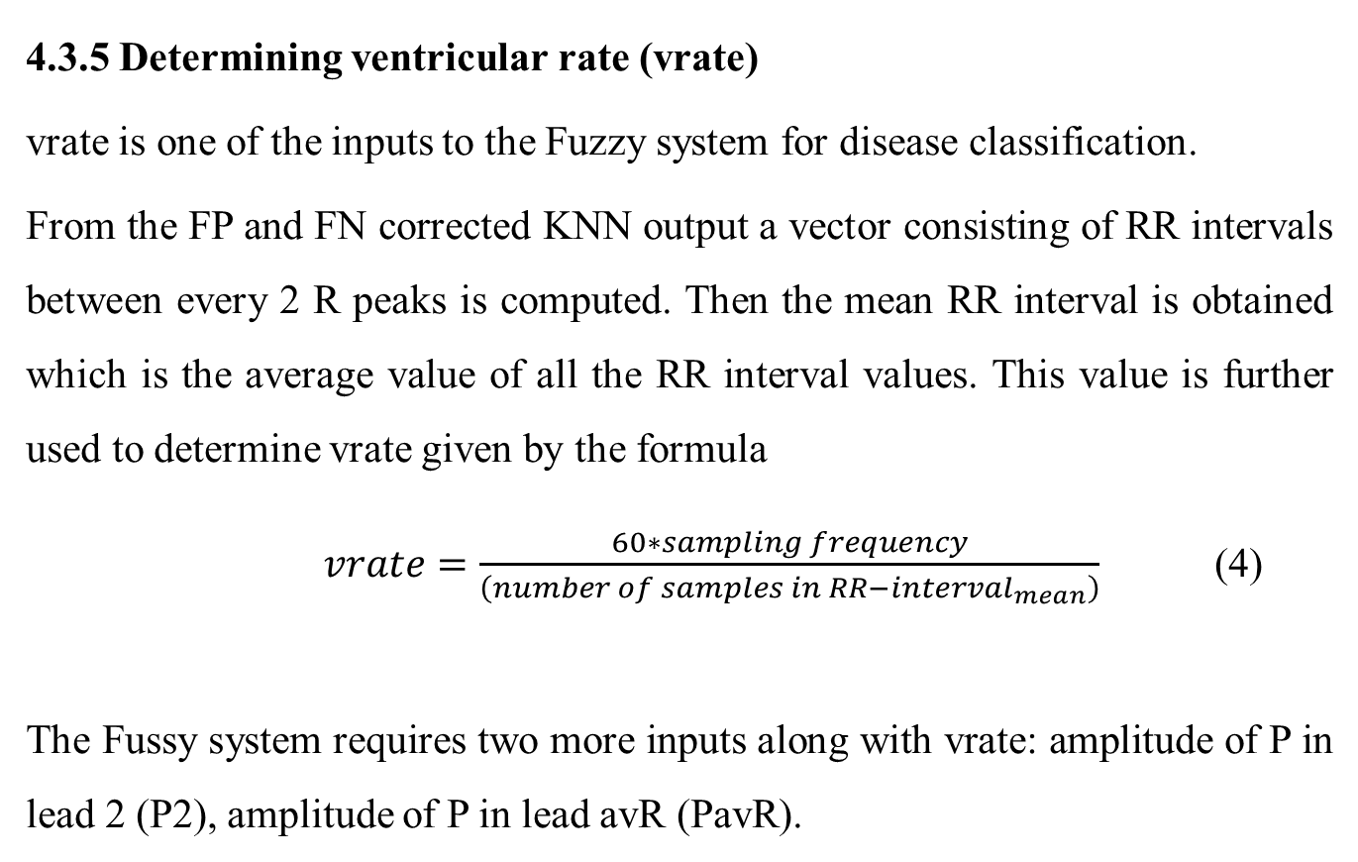
4.3.5 Determining ventricular rate (vrate)
vrate is one of the inputs to the Fuzzy system for disease classification.
From the FP and FN corrected KNN output a vector consisting of RR intervals between every 2 R peaks is computed. Then the mean RR interval is obtained which is the average value of all the RR interval values. This value is further used to determine vrate given by the formula
$vrate=\frac{60∗sampling frequency}{\left(number of samples in {RR−interval}_{mean}\right)}$ (4)
The Fussy system requires two more inputs along with vrate: amplitude of P in lead 2 (P2), amplitude of P in lead avR (PavR).

Slide 26
P2 is obtained by the algorithm described below in section 4.3.5.
4.3.6 Determining P2
The locations of R peaks as obtained in section 4.3.3 are marked.
Baseline wander removed signal is considered. The signal is passed through a lowpass filter with a cut off frequency 5 Hz.
Assuming PR interval in normal range, backward iteration from the locations of R peaks within the normal range is carried out.
Iteration is stopped before the point reaches negative value. The locations of the points are assumed as starting locations of P waves.
Iteration is again carried out in the forward direction from the start points until we reach a maximum value. These point corresponds to P peaks.
P2 is computed by taking the average of all the detected P peaks.

Slide 27
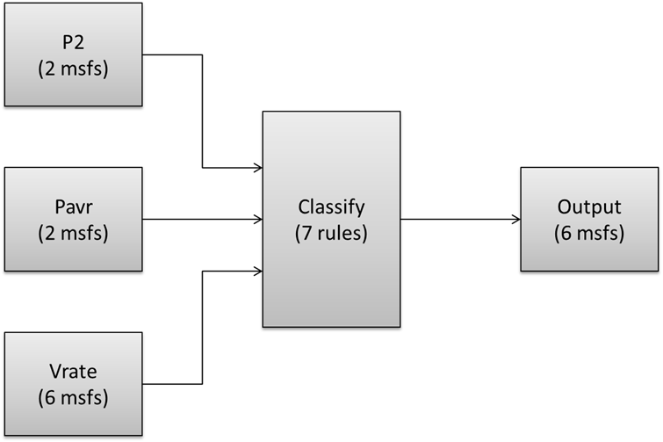
4.4 Disease classification
Disease classification is obtained by classifier designed based on the combination of Fuzzy Logic and KNN model.
4.4.1 Fuzzy system
The diagram shown in Figure 4.2 below represents the fuzzy inference system.
Figure 4.2: Fuzzy inference system

Slide 28
The fuzzy inference system consists of 3 input variables (P2, Pavr, vrate) and 1 output variable.
The input and output variables are fuzzyfied based on quantitative information available from Nova code as shown in Table 4.1. The rules that control the output are described in section 4.4.2.

Slide 29
Table 4.1: Fuzzyfication of input and output variables
Variable | Name of membership function (mf) | Type of membership function | range
P2 | B | Smf | [0 1]
 | EA | Zmf | [-1 -0.1]
Pavr | B | Zmf | [-1 0]
 | EA | Smf | [0.1 1]
vrate | SB | Trimf | [0 25.5 51]
 | EABR | Trimf | [0 25.5 50]
 | NSR | Trimf | [50 72.5 95]
 | EAR | Trimf | [49 70 90]
 | ST | Trimf | [94 122 150]
 | EAT | Trimf | [89 107 150]
output | SB | Trimf | [0 1 2]
 | NSR | Trimf | [2 3 4]
 | ST | Trimf | [4 5 6]
 | EABR | Trimf | [6 7 8]
 | EAR | Trimf | [8 9 10]
 | EAT | Trimf | [10 11 12]

Slide 30
4.4.2 Fuzzy rules
Fuzzy rules are conditional statements based on which the output is controlled. In this project 7 fuzzy rules are defined which are as follows:
If (p2 is B) and (pavr is B) and (vrate is SB) then (output1 is SB) (1)
If (p2 is B) and (pavr is B) and (vrate is NSR) then (output1 is NSR) (1)
If (p2 is B) and (pavr is B) and (vrate is ST) then (output1 is ST) (1)
If (p2 is EA) and (pavr is EA) and (vrate is EABR) then (output1 is EABR) (1)
If (p2 is EA) and (pavr is EA) and (vrate is EAR) then (output1 is EAR) (1)
If (p2 is EA) and (pavr is EA) and (vrate is EAT) then (output1 is EAT) (1)
If (p2 is B) and (pavr is B) and (vrate is SB) then (output1 is SB) (1)

Slide 31
vrate and P2 to be fed as inputs to the Fuzzy system are obtained as described in sections 4.3.5 and 4.3.6 respectively. Pavr is arbitrarily selected as lead avr is unavailable in the database.
Based on the inputs and rules crisp numeric value is obtained at the output which is further fed into the KNN model for disease classification.

Slide 32
4.4.3 Disease classification using KNN
The KNN classification model is trained with the following input and response variables.
Based on the training data mentioned above, when a numeric value derived from the output of the fuzzy system is given to the model, corresponding class label is assigned to the input by the classification model.
Table 4.2: Training data for KNN model
Input | Class label
1-2 | Sinus Bradycardia (SB)
3-4 | Normal sinus Rhythm (NSR)
5-6 | Sinus Tachycardia (ST)
7-8 | Ectopic Atrial Bradycardia (EABR)
9-10 | Ectopic Atrial Rhythm (EAR)
11-12 | Ectopic Atrial Tachycardia (EAT)

Slide 33
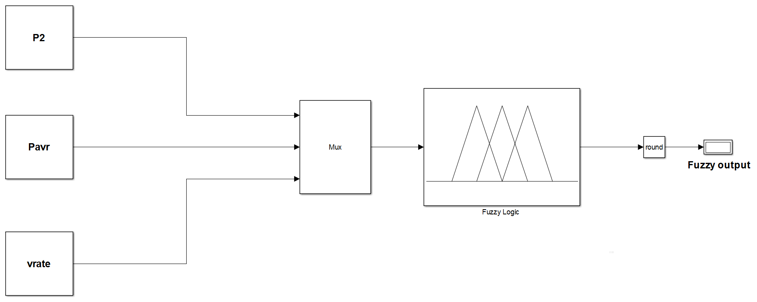
4.4.4 Simulation
The algorithm is simulated in simulink. Figure 4.3 illustrates the simulation model.
Figure 4.3: Simulation model for the designed algorithm

Slide 34
5. Results and Discussion
For illustration record 800 of MIT-BIH Supraventricular Arrhythmia is used for training the KNN model. The KNN model is further tested with rest of the signals from the same database.
The first stage is signal acquisition followed by bandpass filtering to remove the influence of power line interference and motion artifacts as shown in Figure 5.1.

Slide 35
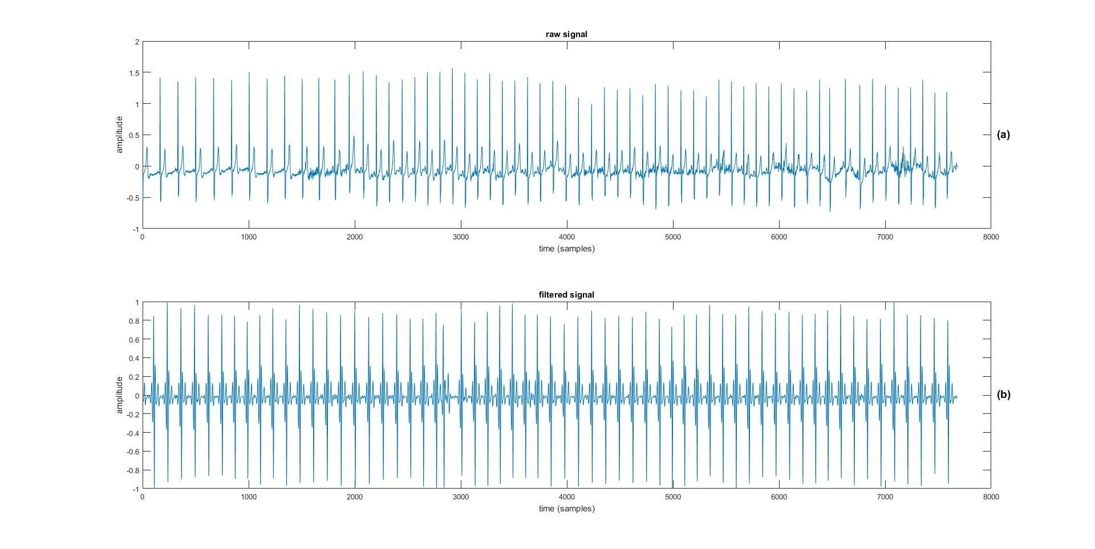
Figure 5.1.(a) shows raw ECG signal. Figure 5.1.(b) shows bandpass filtered signal.
Figure 5.1: Input signal to KNN: record 800 of MIT-BIH Supraventricular Arrhythmia Database:
(a) Raw ECG signal, (b) Filtered signal

Slide 36
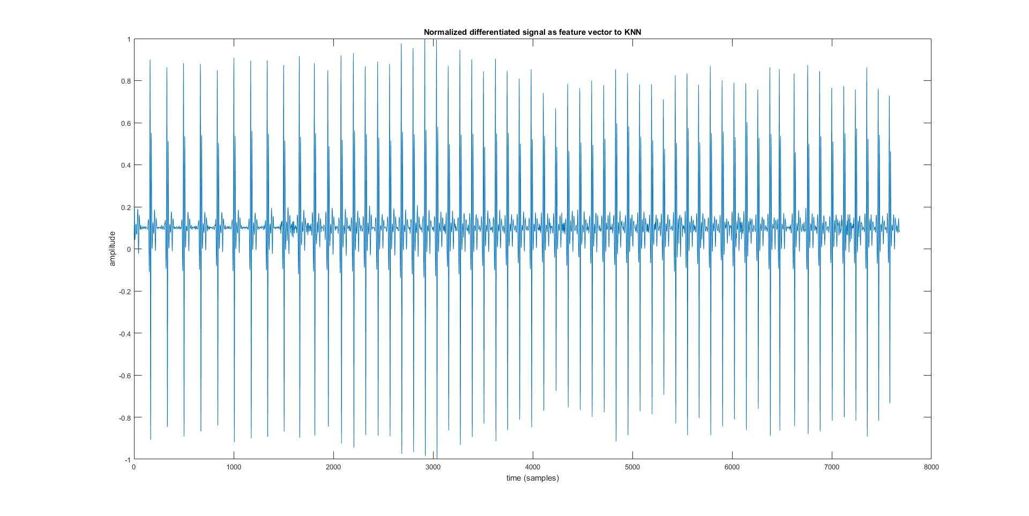
The next stage is KNN classification to detect QRS complex. The signal is filtered and normalized as shown in Figure 5.2.
The normalized differentiated signal so obtained is used as feature vector in training KNN classifier.
Figure 5.2: Normalized differentiated signal used as feature vector for KNN classifier

Slide 37
After training the model is tested with rest of the records. However for illustration the results of records 802, 811 and 855 of MIT-BIH Supraventricular Arrhythmia database are displayed.
Figure 5.3 shows QRS detection obtained from KNN and corrected FPs and FNs for record 802. Figure 5.3(a), shows filtered signal superimposed with KNN detected R peaks. Figure 5.3(b), shows filtered signal superimposed with FP and FN corrected R peaks.

Slide 38
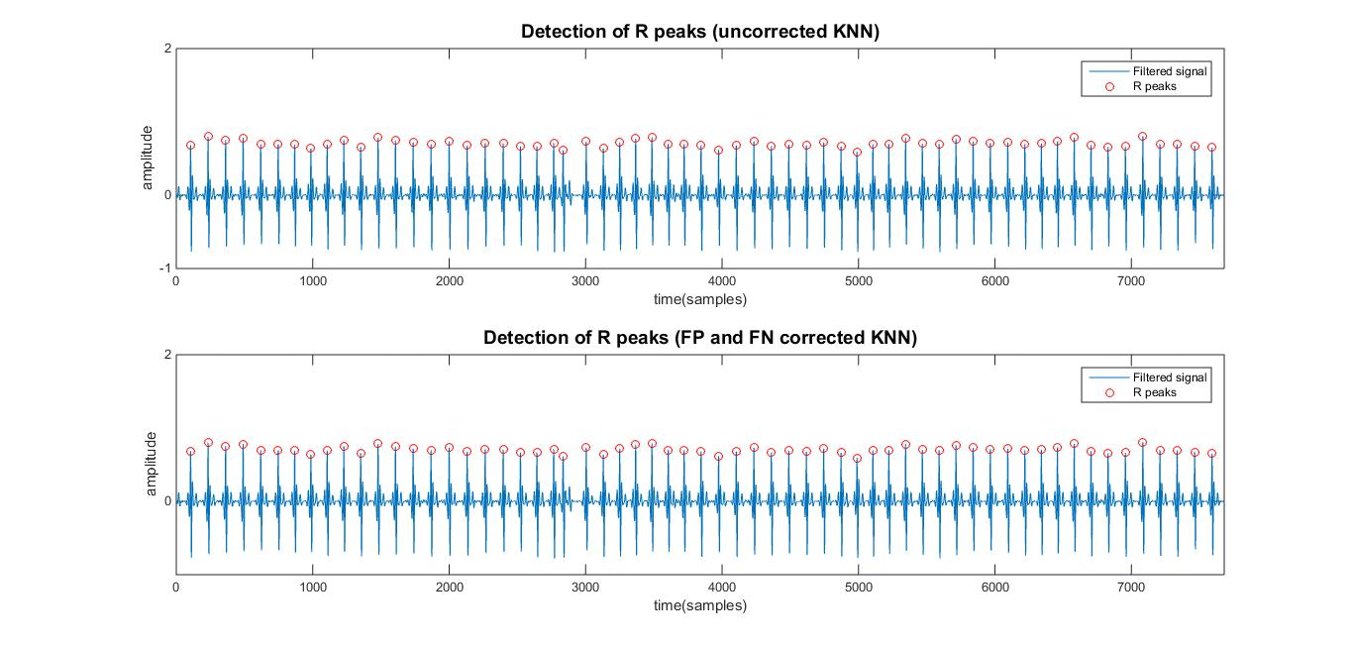
(a)
(b)
Figure 5.3: QRS detection for record 802:
(a) filtered signal superimposed with R peaks; (b) filtered signal superimposed with FP and FN corrected R peaks

Slide 39
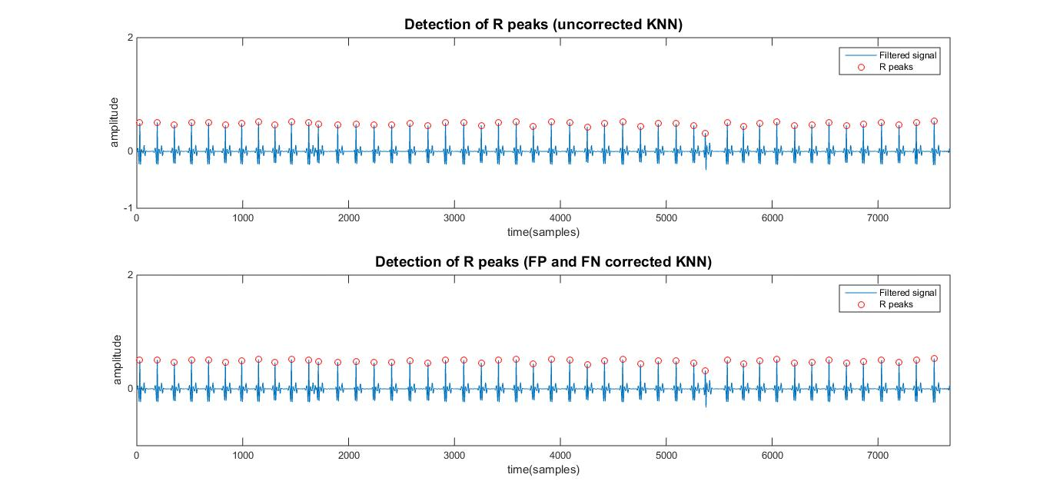
Figure 5.4 shows QRS detection obtained from KNN and corrected FPs and FNs for record 811. Figure 5.4(a), shows filtered signal superimposed with KNN detected R peaks. Figure 5.4(b), shows filtered signal superimposed with FP and FN corrected QRS peaks.
(a)
(b)
Figure 5.4: QRS detection for record 811:
(a) filtered signal superimposed with R peaks; (b) filtered signal superimposed with FP and FN corrected R peaks

Slide 40
The KNN output doesn’t shown any FPs or FNs in records 802 and 811, therefore corrected output is same the KNN output.
However KNN output for record 855 shows FNs. Figure 5.5 shows QRS detection obtained from KNN and corrected FPs and FNs for record 855 Figure 5.5(a), shows filtered signal superimposed with KNN detected R peaks. Figure 5.5(b) shows filtered signal superimposed with FNs and Figure 5.5(c) shows filtered signal superimposed with FP and FN corrected R peaks.

Slide 41
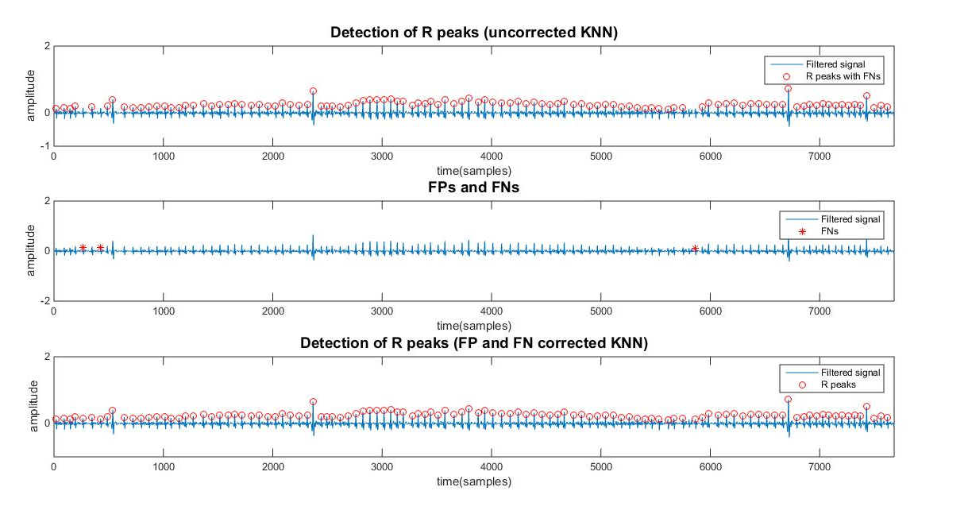
(a)
(b)
(c)
Figure 5.5: QRS detection for record 855:
(a) filtered signal superimposed with R peaks; (b) filtered signal superimposed with FNs; (c) filtered signal superimposed with FP and FN corrected R peaks

Slide 42
To illustrate FP removal the KNN result and FP and FN corrected result for record 812 is shown in Figure 5.6.
Figure 5.6(a) shows filtered signal superimposed with KNN detected R peaks. Figure 5.6(b) shows filtered signal superimposed with detected FPs and Figure 5.6(c) shows filtered signal superimposed with FP and FN corrected R peaks.

Slide 43
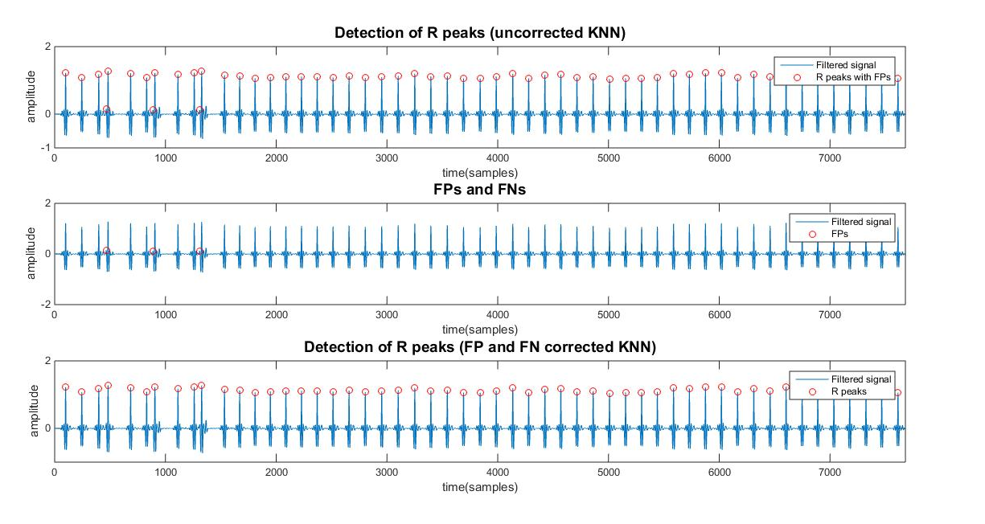
(a)
(b)
(c)
Figure 5.6: QRS detection for record 812:
(a) filtered signal superimposed with R peaks; (b) filtered signal superimposed with FPs; (c) filtered signal superimposed with FP and FN corrected R peaks

Slide 44
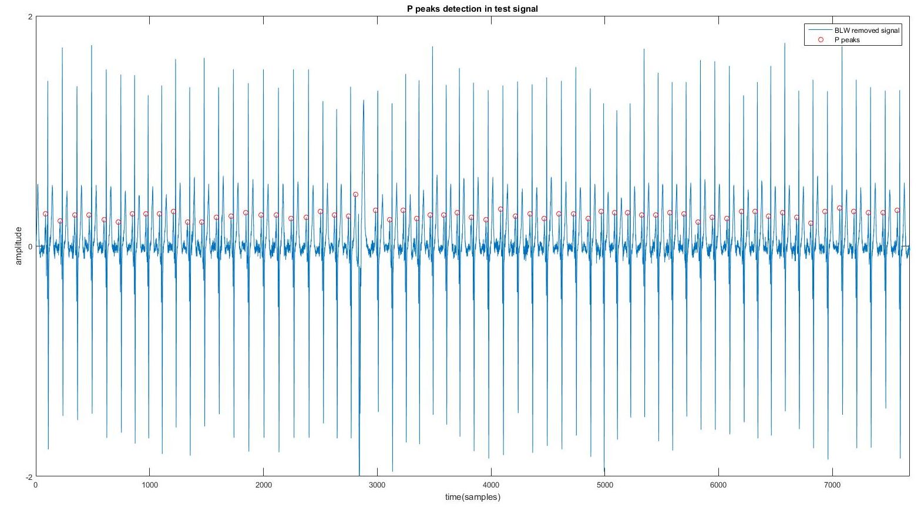
The next stage is P peak detection. Figures 5.7, 5.8 and 5.9 shows P peaks detected results for records 802, 811 and 855 respectively.
Figure 5.7: P peak detection for record 802

Slide 45
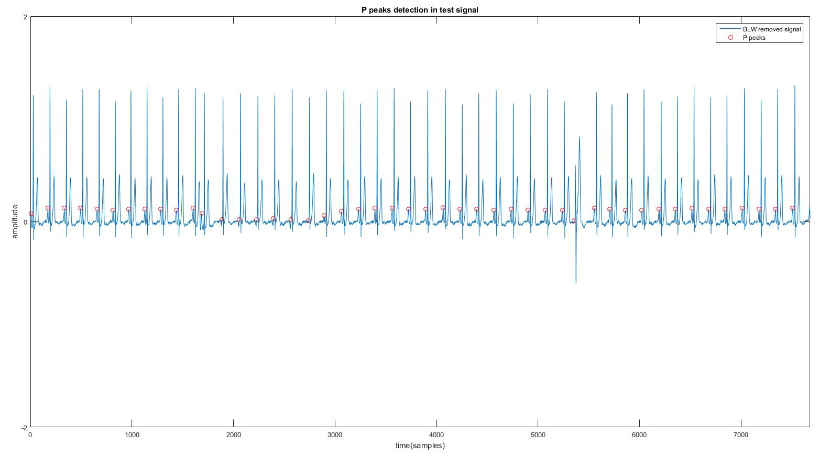
Figure 5.8: P peak detection for record 811

Slide 46
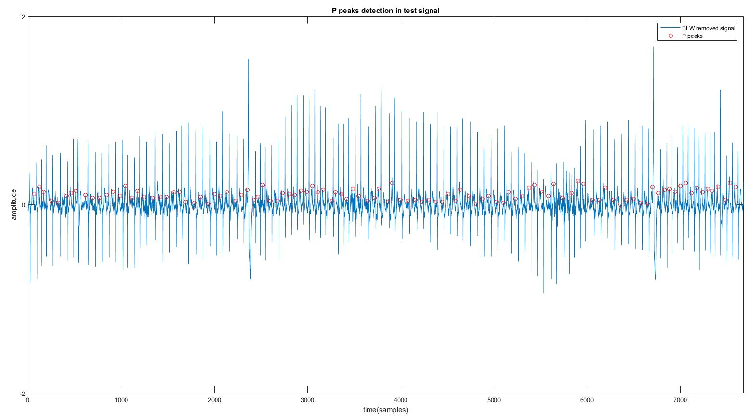
Figure 5.9: P peak detection for record 855

Slide 47
The next stage is disease classification by a classifier which consists of Fuzzy system and KNN model.
Based on the given inputs the Fuzzy system returns a crisp numeric value at the output end which is further classified as a particular disease by the KNN model based on the training parameters given in Table 4.2 .
Figures 5.10, 5.11 and 5.12 shows disease classification results for records 802, 811 and 855 respectively.

Slide 48
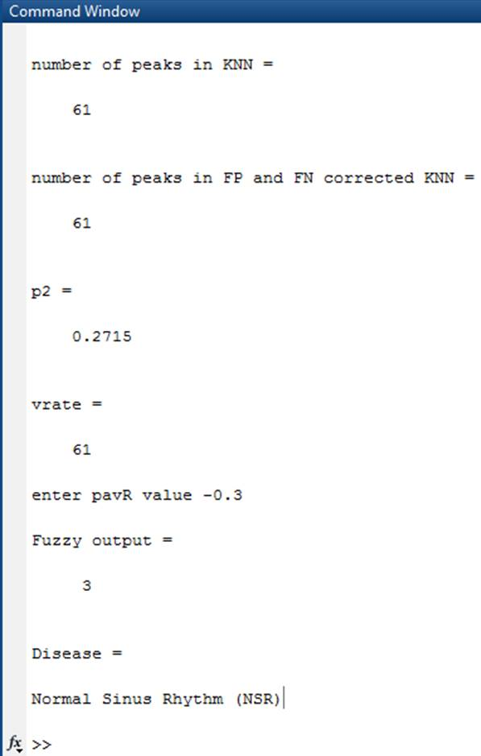
Figure 5.10: Disease classification for record 802

Slide 49
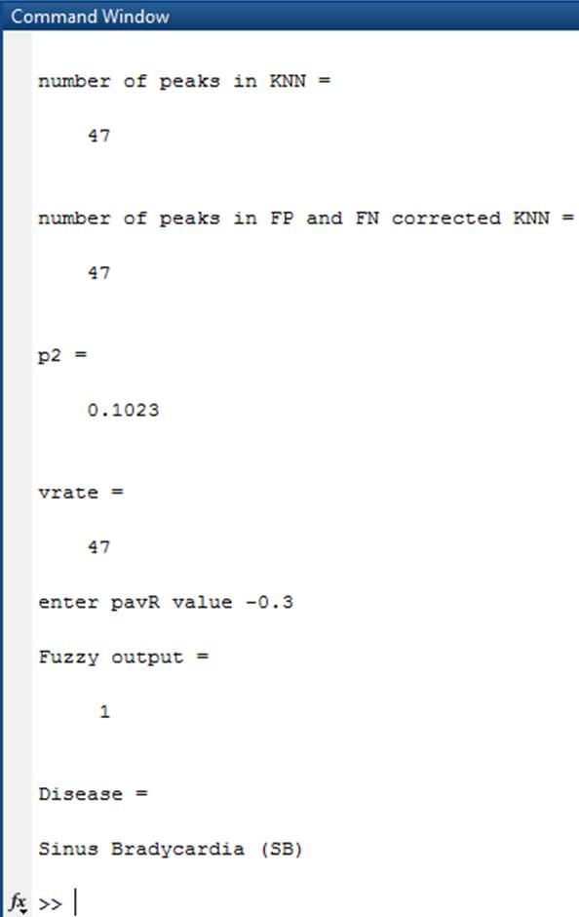
Figure 5.11: Disease classification for record 811

Slide 50
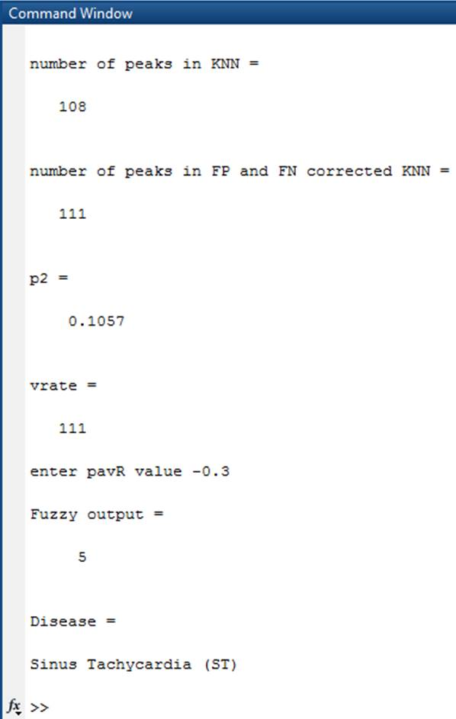
Figure 5.12: Disease classification for record 855

Slide 51
Table 5.1, 5.2 and 5.3 shows evaluation results for other test inputs of MIT-BIH Supraventricular Arrhythmia database, MIT-BIH Arrhythmia database and Laboratory signals respectively.
The evaluation parameters chosen are detection rate (DR), Sensitivity (SE) and Specificity (SP) in percentages given by
DR=(TP-FN)/TP (5)
SE=TP/(TP+FN) (6)
SP=TP/(TP+FP) (7)
Where
TP - True positive; FN - False negative; FP – False positive

Slide 52
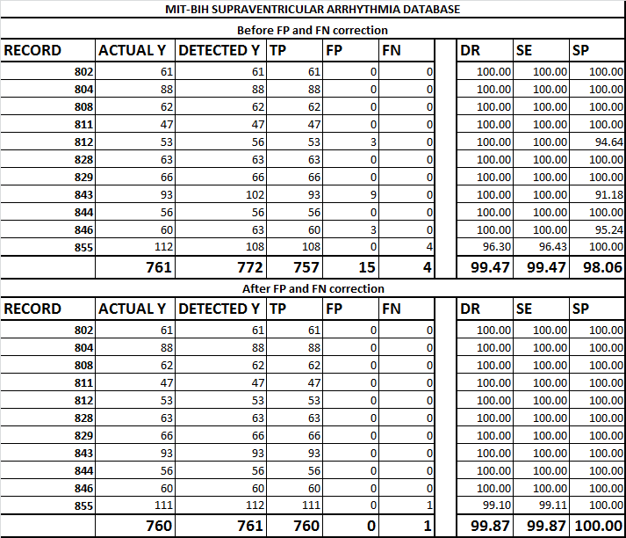
Table 5.1, shows evaluation results for other test inputs of MIT-BIH Supraventricular Arrhythmia database.

Slide 53
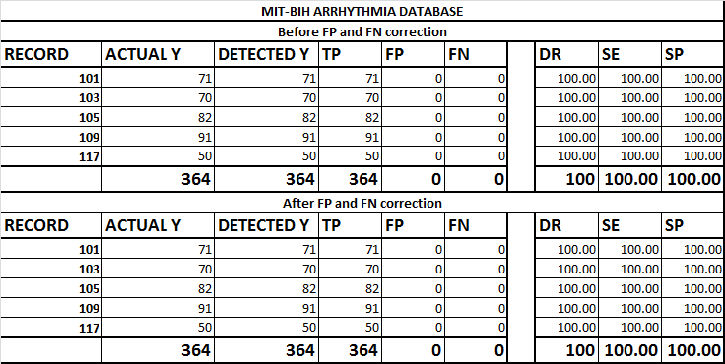
Table 5.2, shows evaluation results for other test inputs of MIT-BIH Arrhythmia database.

Slide 54
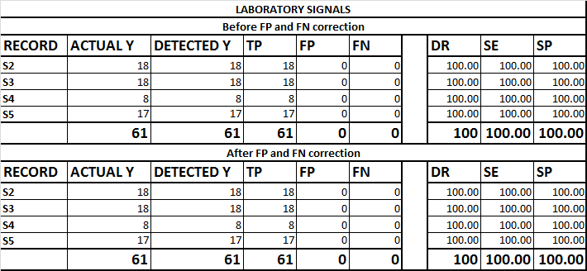
Table 5.3, shows evaluation results for other test inputs of laboratory signals.

Slide 55
To summarize, the results obtained for detection of QRS complex show detection rate (DR) of 99.47 %, Sensitivity (SE) of 99.47% and Specificity (SP) of 98.06 before FP/FN correction; DR of 99.87%, SE of 99.87% and SP of 100% after FP/FN correction. Therefore, there is an overall improvement compared to the earlier work.
The P detection algorithm was able to detect most of the p peaks with negligible false positives and false negatives.
The disease classification was found to be accurate for the given input parameters. The classifier was able to exactly predict the type of Arrhythmia from the given input signal.

Slide 56
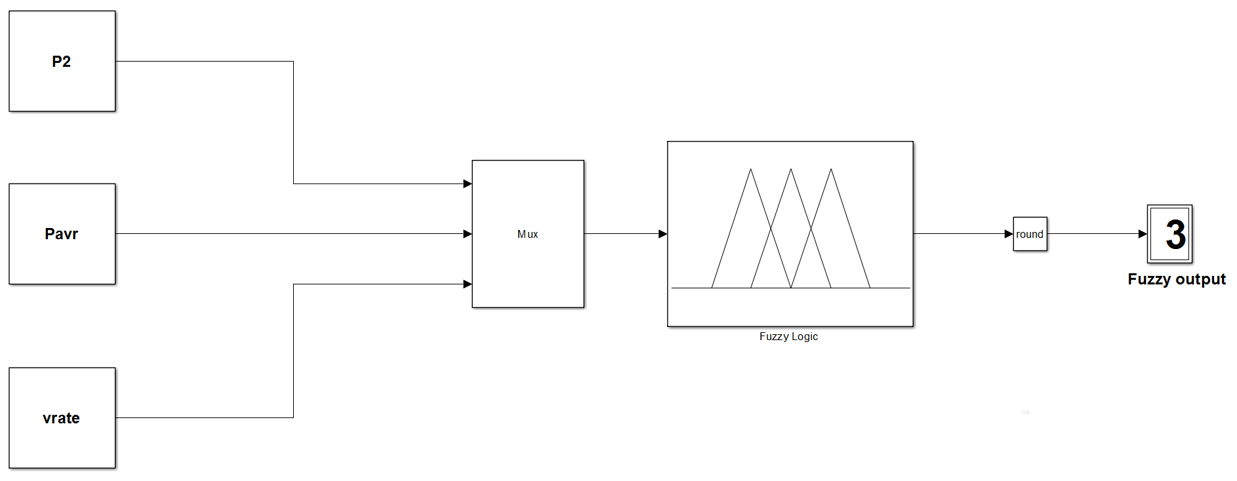
The Fuzzy simulation result for record 802 is illustrated in Figure 5.13.
Figure 5.13: Fuzzy Simulation result for record 802

Slide 57

The Fuzzy simulation result for record 811 is illustrated in Figure 5.14.
Figure 5.14: Fuzzy Simulation result for record 811

Slide 58

The Fuzzy simulation result for record 855 is illustrated in Figure 5.15.
Figure 5.15: Fuzzy Simulation result for record 855

Slide 59
6. Innovations in this project
The very idea of providing a handy automated tool for ECG interpretation is an innovation, resulting in avoidance of errors in interpretations
Improvements to the earlier KNN based QRS detection by designing false positive (FP) and false negative (FN) correction algorithm.
P peaks detection algorithm from the obtained KNN output
Use of fuzzy logic to develop the classifier.
Use of Nova code standard in the setting the rules for fuzzy systems.
Classifier as a combination of fuzzy system and KNN model.

Slide 60
7. Conclusion
In this project, an attempt was made to design an automated disease identification system that can serve as a handy tool for doctors and other medical professionals during diagnosis.
The classifier designed consists of two components, a fuzzy system and KNN model. Fuzzy logic is employed, as the disease characteristics vary over a range of values instead of a definite value.
To enhance the authenticity of classification model, quantitative information available from the Nova code, which is widely used as a standard in clinical trials, is utilised to design fuzzy system.

Slide 61
Clinically significant features of an ECG signal such QRS complex is extracted using KNN classification algorithm.
The model is tested with very few inputs since the main aim of this work is to develop a disease classification system.
However, there is scope for validation with more number of inputs and after extraction of all relevant features while incorporating entire Nova code.
A custom algorithm for detecting FPs, FNs and P peaks were designed and tested which is an improvement to the existing work.
The results obtained for detection of QRS complex show detection rate (DR) of 99.47 %, Sensitivity (SE) of 99.47% and Specificity (SP) of 98.06 before FP/FN correction; DR of 99.87%, SE of 99.87% and SP of 100% after FP/FN correction. Therefore, there is an overall improvement compared to the earlier work.

Slide 62
The P detection algorithm was able to detect most of the p peaks with negligible false positives and false negatives.
The disease classification was found to be accurate for the given input parameters. The classifier was able to exactly predict the type of Arrhythmia from the given input signal.
To illustrate the concept, various types of arrhythmias are selected as disease classes. However the scope can be further increased to incorporate the entire Nova Code.

Slide 63
References
Sinus rhythm. [Online]. Available:http://ekg.academy/cardiac-rhythm-analysis.aspx (free source) [Accessed on 20/01/2016].
F. Zhang, Y. Lian, “QRS Detection based on Multiscale Mathematical Morphology for Wearable ECG Devices in Body Area Networks”, IEEE Transactions on Biomedical Circuits and Systems, 2009, 3(4), 220-28.
I. Saini, D. Singh, A. Khosla, “QRS Detection using K-Nearest Neighbour Algorithm (KNN) and Evaluation on Standard ECG Databases”, Journal of Advanced Research, 2013, 4(1), 331–344.
22. S. Yazdani, J. M. Vesin, “Adaptive Mathematical Morphology for QRS Fiducial Points Detection in the ECG”, IEEE Conference on Computing in Cardiology 2014, 7-10 September 2014, 725-28.

Slide 64
P. M. Rautaharju, H. P. Calhoun, B. R. Chaitman, “Novacode Serial ECG Classification System for Clinical Trials and Epidemiologic Studies”, Journal of Electrocardiology, 1991, 24(1), 179-187
A. E. Awodeyi, S. R. Alty, M. Ghavami, “Median based Method for Baseline Wander Removal in Photoplethysmogram Signals”, IEEE International Conference on Bioinformatics and Bioengineering, 2014, 311-314.

Slide 65
Thank you

